Slide 1





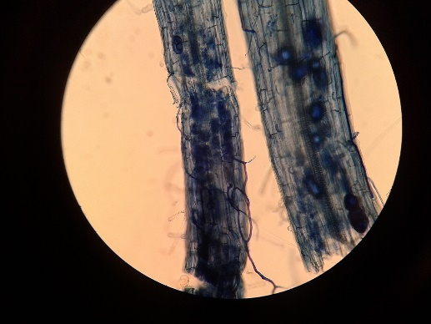
EXPERIMENTAL DESIGN
Sampling 3rd and 4th leaves
10 days
4-5 weeks
NM
NM inf
AM
AM inf
24 , 48 hours post infection
AMF inoculation
B.cinerea infection
BOTRYTIS CINEREA (PATHOGENIC FUNGI)
Rhizophagus irregularis
SOLANUM LYCOPERSICUM
(BENEFICIAL FUNGI: ARBUSCULAR MYCORRHIZAL FUNGI)
Notes:
In this work, we have two different timepoints: 6 and 24 hpi.

Slide 2
Sampling 3rd and 4th leaves of each plant (or same stage)
Each biological replicate contain 3 plants
NM: control plants (non-treated; non-infested)
NM inf: control infested plants
AM: Arbuscular mycorrhizal plants non-infested
AM inf: Arbuscular mycorrhizal infested plants
NM
NM inf
AM
AM inf
AIM OF THIS STUDY: TO FIND CONEXIONS BETWEEN DIFFERENT MOLECULAR LEVELS TO UNDERSTAND WHICH ARE THE MECHANISMS OF MYCORRHIZAL INDUCED RESISTANCE IN TOMATO PLANTS AGAINST THE NECROTROPHIC FUNGI BOTRYTIS CINEREA.

Slide 3
Metabolome: 3 biological replicates + 3 techn 24 and 48 hpi
Enzymome: 6 replicates, 24 and 48 hpi. (24 enzymes)
RNA-seq: 3 replicates, 24 and 48 hpi
Phosphoproteome: 4 replicates (except AM, 3 replicates) , 24 hpi
Proteome: 3 replicates, 24 hpi

